Slide 1
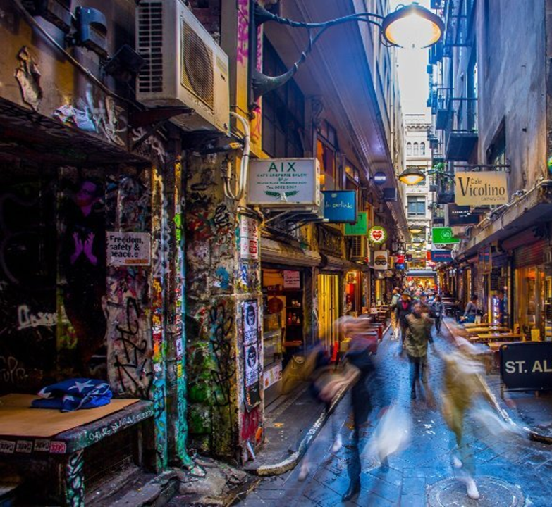
Eat & Drink
Melbourne (2002 – 2020)
David Salim
Ron Fu
Sam Vuong
Steven Bouios
Group 7

Slide 2
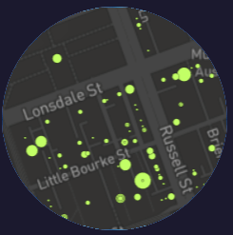


Agenda
Our story
Plan & Design
Coding Approaches
Data Munging
Process
Final visualisation - demo

Slide 3
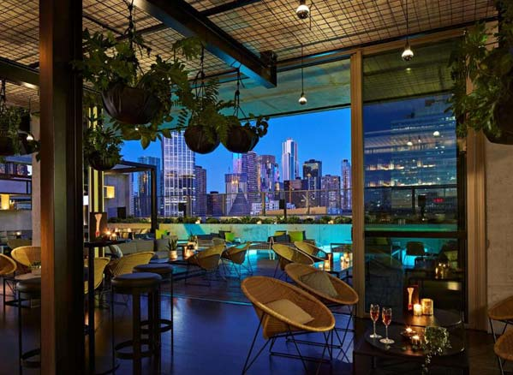
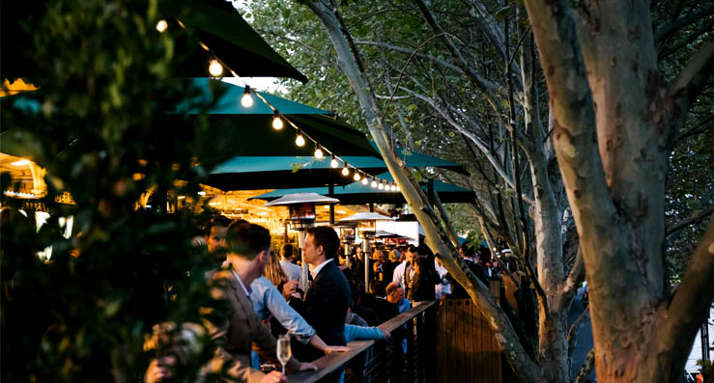
Our story
Cafes & Restaurants
City of Melbourne
2002 to 2022

Slide 4

Plan & Design
Dashboard
Table
Map

Slide 5
Coding approach
Dashboard
Table
Map

Slide 6
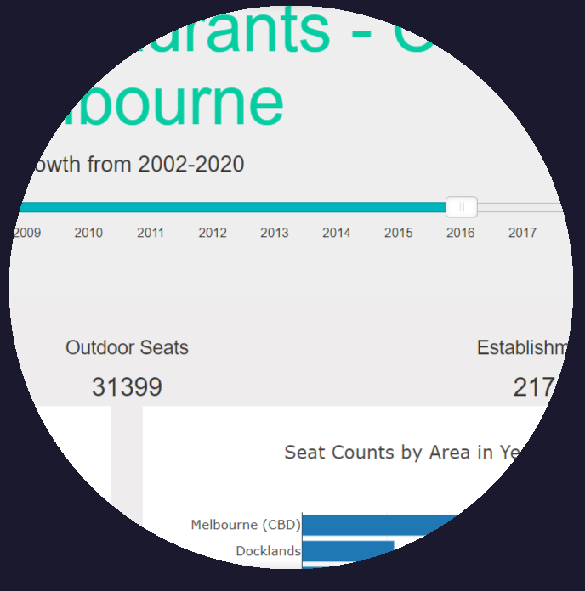
Dashboard
Slider (JS library)
Function to build charts
D3

Slide 7
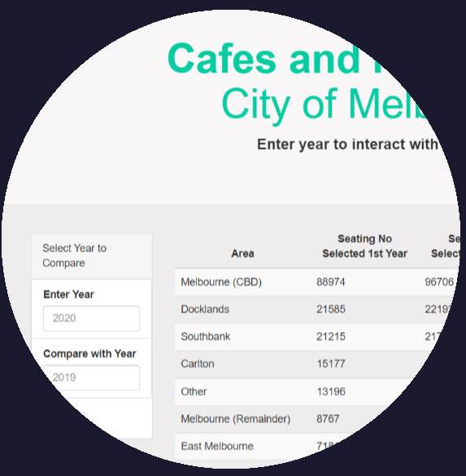
Table
D3
API – enter 2 different year as input

Slide 8
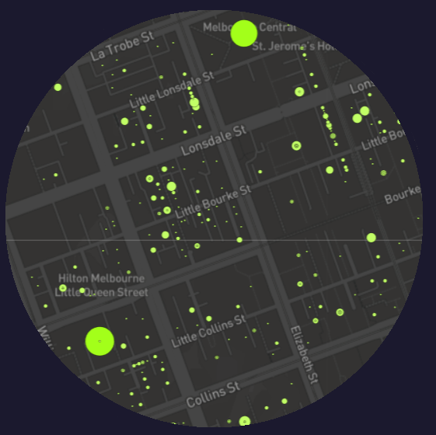
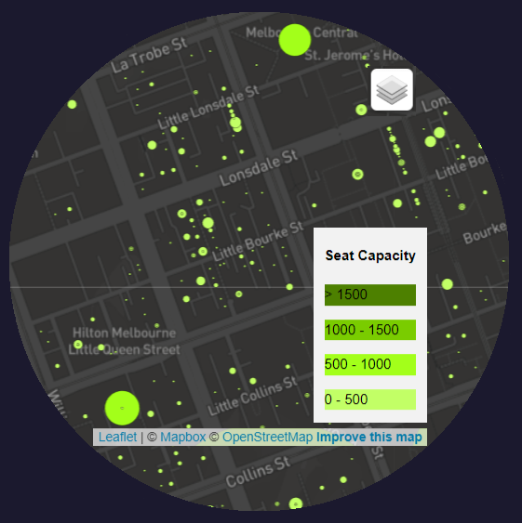
Map
Leaflet
Control layers:
Tile layers
Data by year

Slide 9
Data Munging

Slide 10
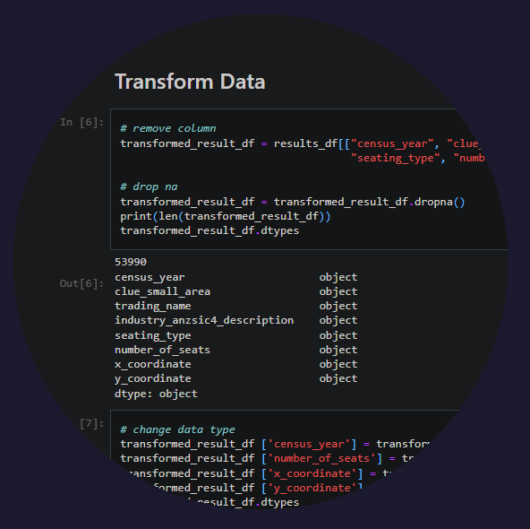
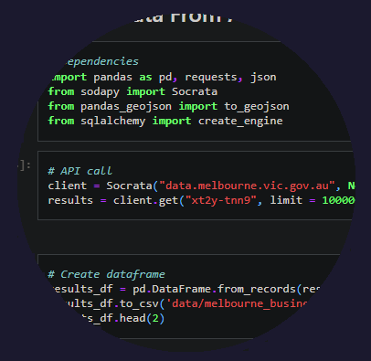
Data Munging
Pandas: dataframe
remove columns,
dropna,
drop duplicates,
change data type,
replace

Slide 11
Process

Slide 12
Process
melbourne.vic.gov.au
.ipynb
Python flask server
JS
API: chart
.csv
API: map
.html
sqlite
API: table
Heroku (stay tuned)

Slide 13
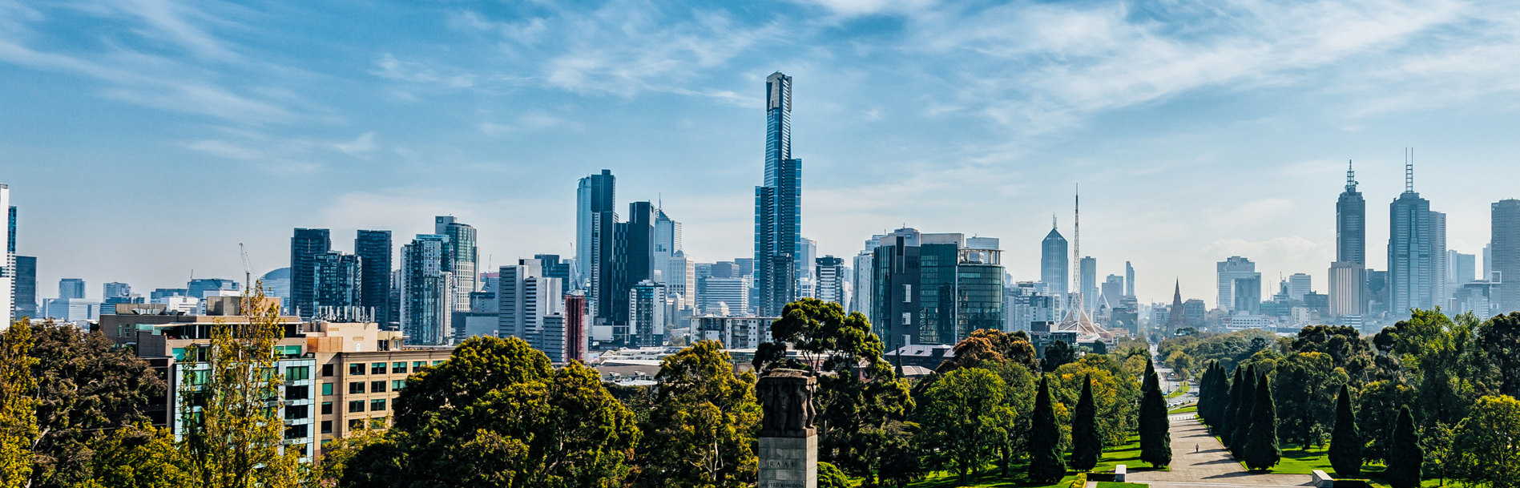
Demo

Slide 14


Thank You

